Slide 1
SyriaTel – Customer Churn Assessment August 26, 2022
Presented by:
Ali Rampurawala
Legendary Preds Inc.

Slide 2

Business Problem
Significant increase in customer churn rates
Impacting bottom line
Objective: Predict which customers are likely to churn

Slide 3
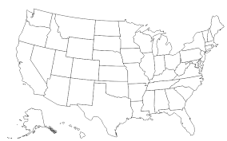



Key Questions
Total Charges?
Did the Customer Churn?
Location?
Total Usage?

Slide 4
Data
Historical Data (~3,300 records)
Includes:
State
Minutes (day, eve, etc.)
Charges (day, eve, etc.)
Churn (~14%)

Slide 5
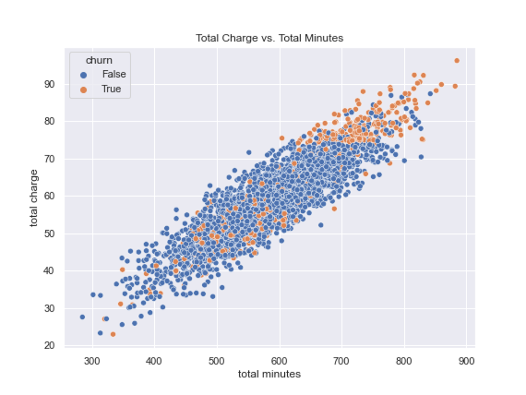
Initial Observations
Your “High-End” (best) Customers are Churning…

Slide 6
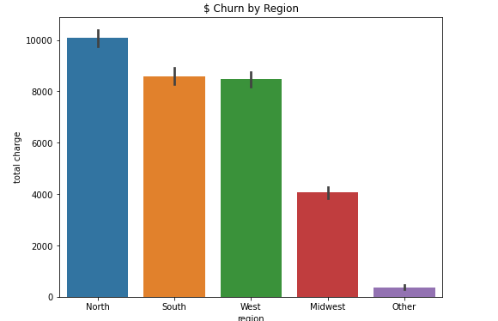
Initial Observations
Churn ($) is highest in the North

Slide 7
Final Model
After running hundreds of model iterations…
Final Accuracy Score: 97%
So…what does this mean?

Slide 8

Key Take Aways
Based on unseen data:
Recall = 80%: (100/125 customers)
Precision = 100% (100/100 customers)
SyriaTel’s time and resources will not be wasted!

Slide 9
Recommendations
At the end of each quarter, feed model with active customer account data
Focus on customers that are identified by the model
Prioritize newly flagged customers
Provide discounts, consider rolling out “unlimited” plans by region, and assign top customer service reps

Slide 10
Closing thoughts
Things to explore
If given additional time…
Further tune the model to increase the “recall” score
Continue to add data each quarter and update model
Analyze new customer data to help identify potential trends

Slide 11
Thank You….
Any questions?
Email: Ali.Rampurawala@gmail.com
Github Link

